Slide 1
Lab 10 – RGB Color Display
Mary Hager
Digital Design

Slide 2
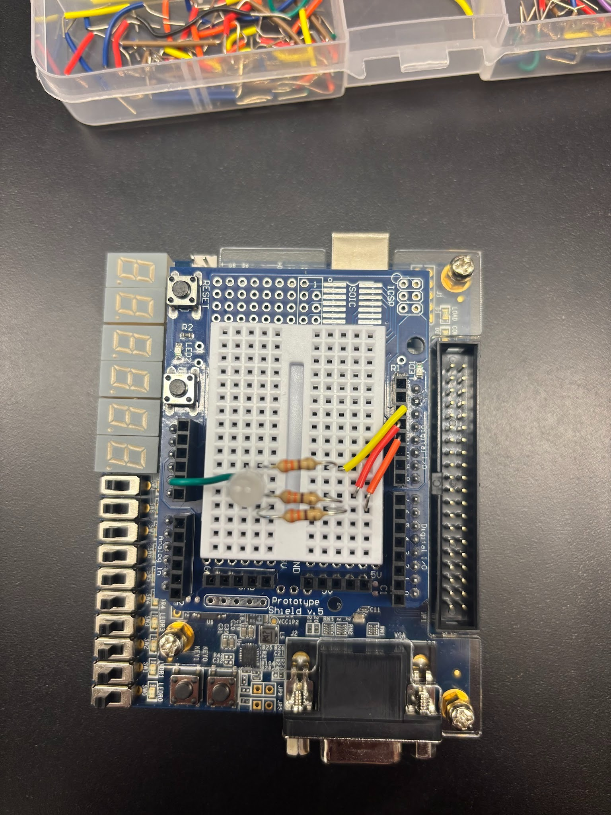
FPGA Set-up
RGB LEDs connected to output pins 13, 12, 11
Ground pin connected to GND

Slide 3
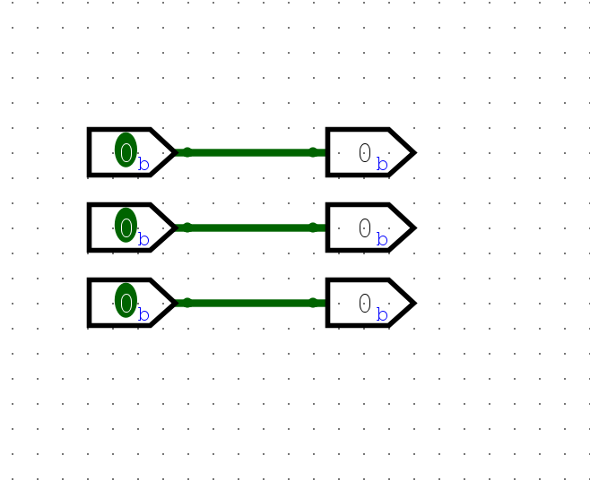
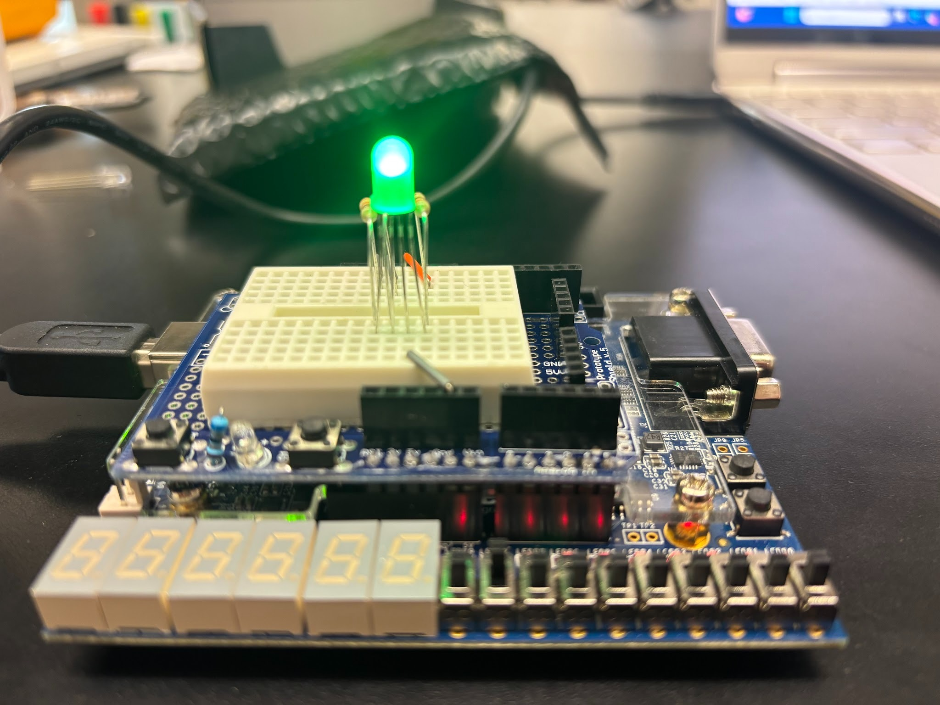
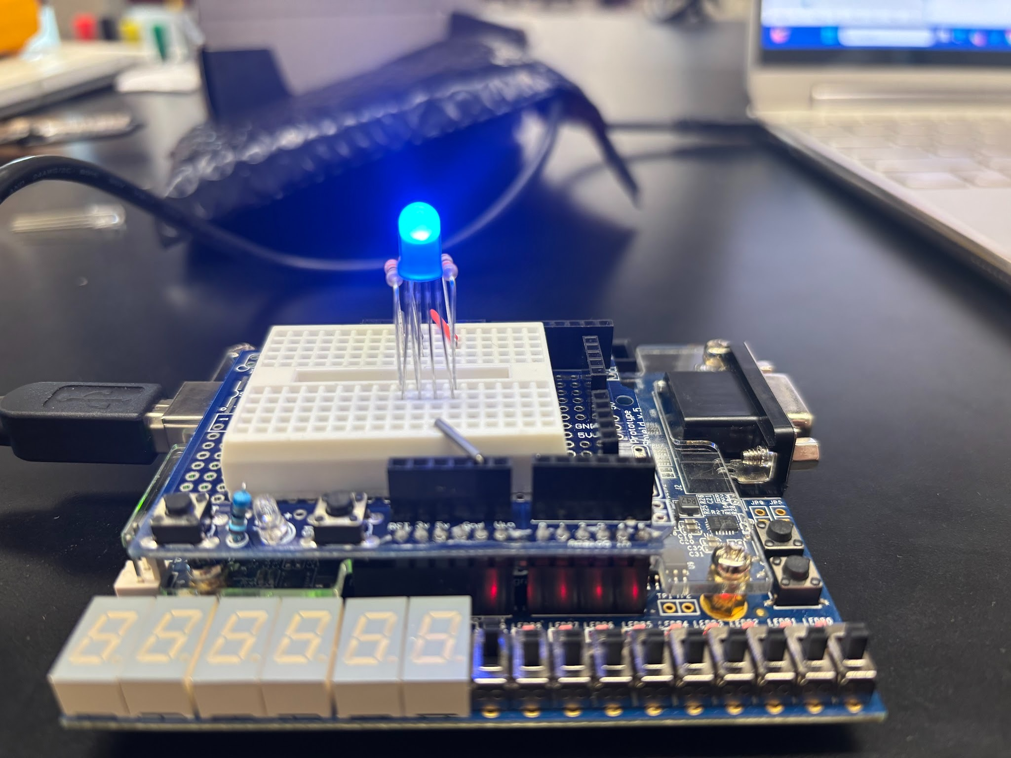
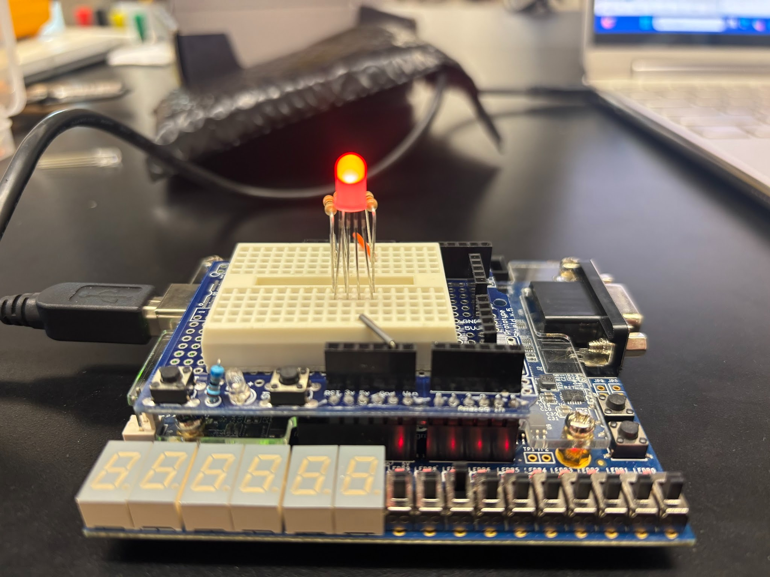
BEHAVIOR 1 – Turn on RGB LEDs via switches
Inputs correspond to 3 different switches
Outputs correspond to the 3 legs of the LED
Inputs and Outputs are mapped to switches and output pins on FPGA Sheild

Slide 4
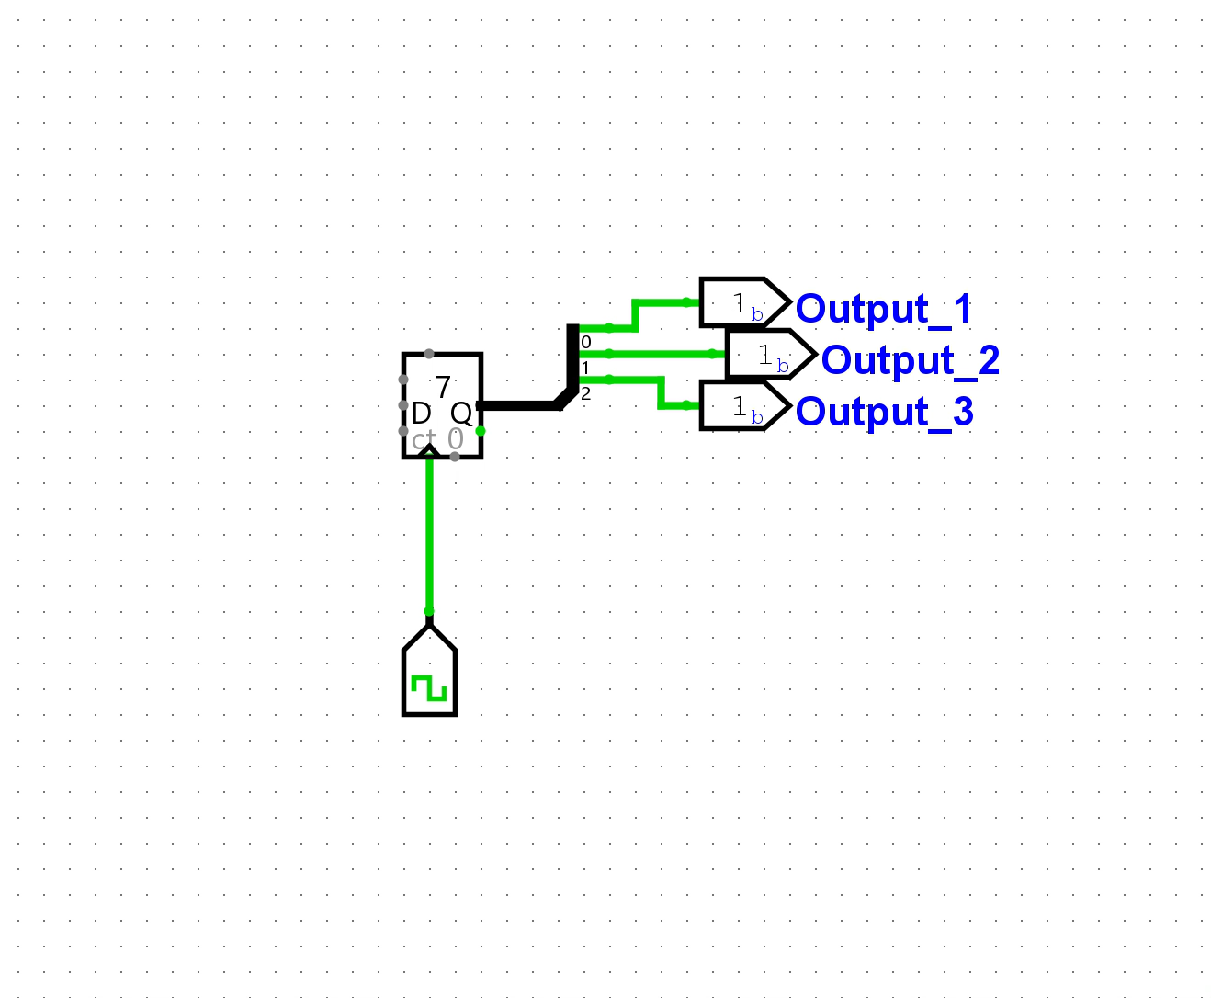
Behavior 2: Cycle through 8 Stages/Color Combinations of RGB Values
RED
GREEN
BLUE
YELLOW (RED + GREEN)
LIGHT BLUE (BLUE + GREEN)
PURPLE (RED + GREEN)
ALL LED VALUES OFF
ALL LED VALUES ON (WHITE)
Because there was 8 distinct stages, a counter was used to alternate between each combination of lights from 000 to 111.
Synthesized successfully and implemented on to FPGA shield.

Slide 5
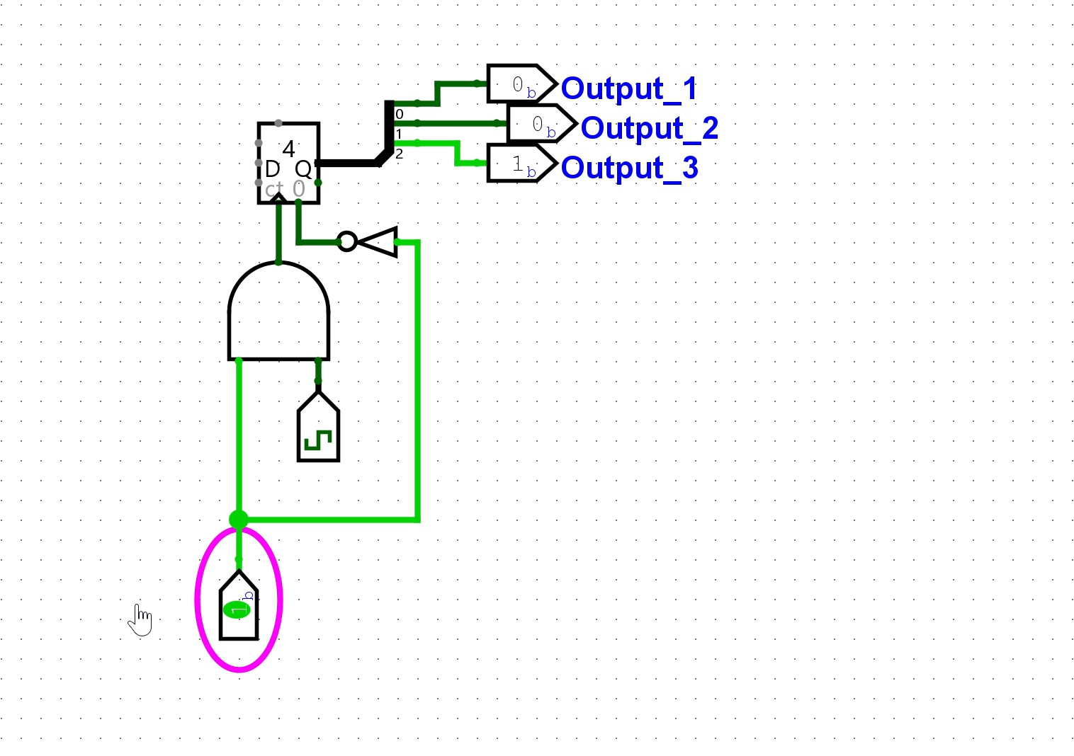
All Colors Cycle Being Enabled and Reset

Slide 6
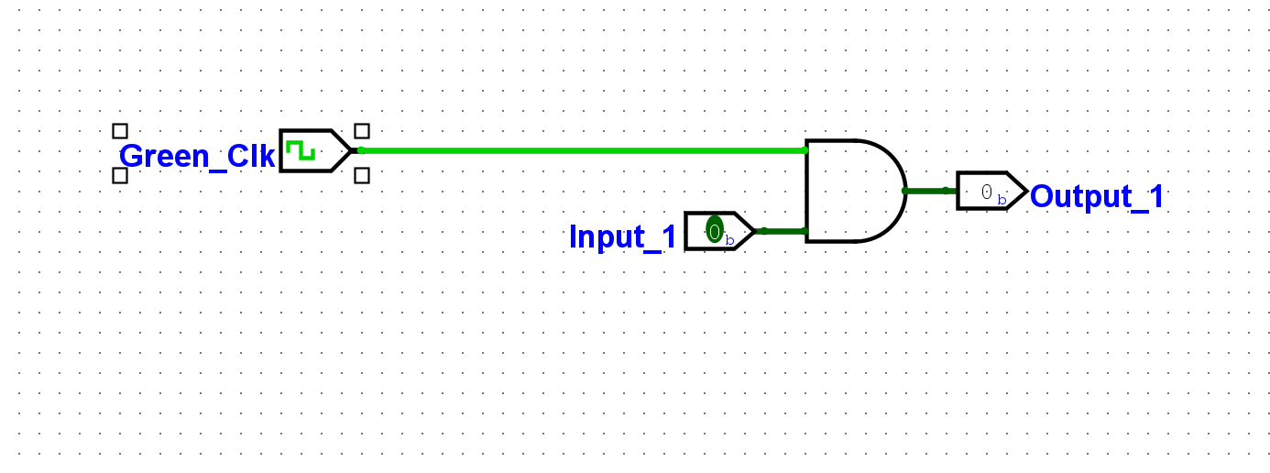
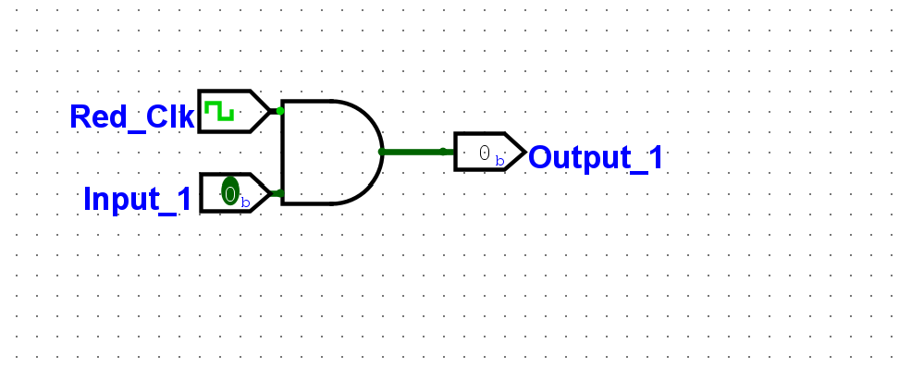
Red and Green Blinking
Issue: Clock runs at the same rate

Slide 7
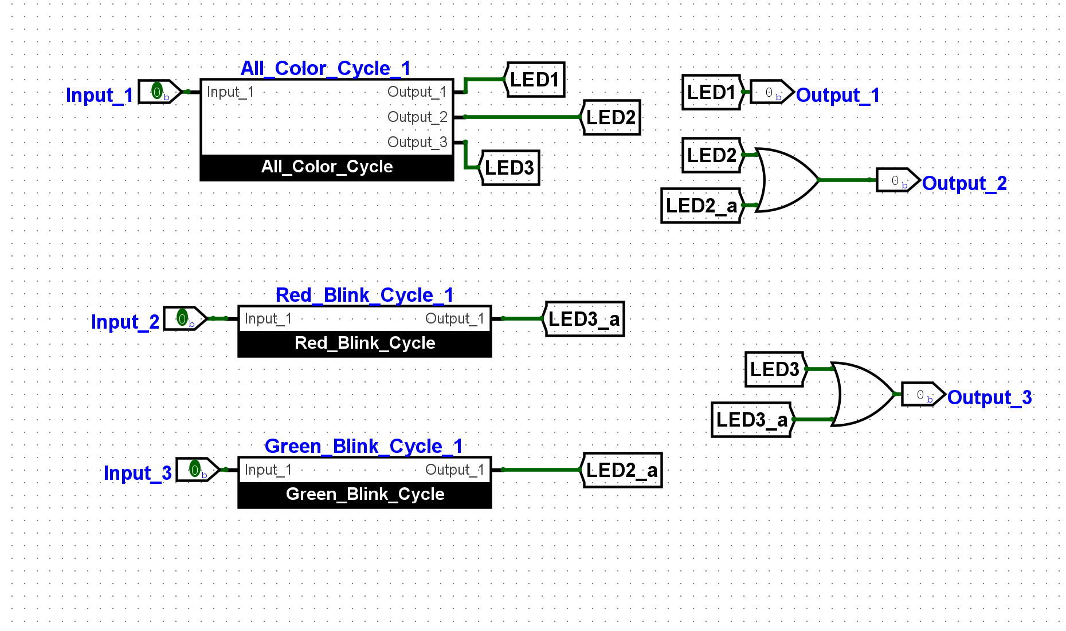
Successfully transitions between cycles

Slide 8
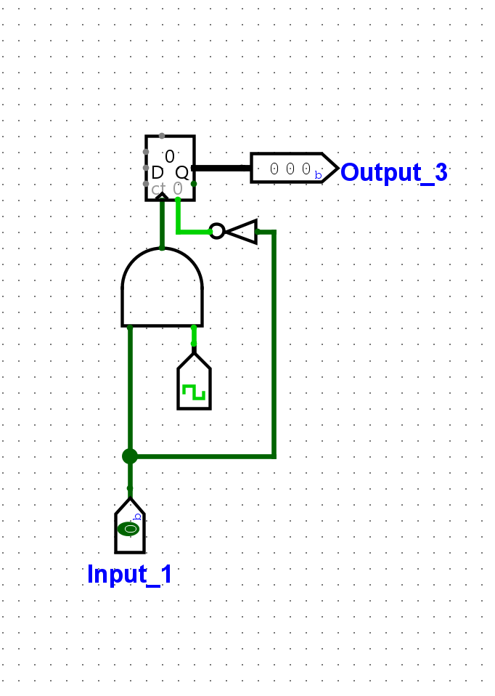
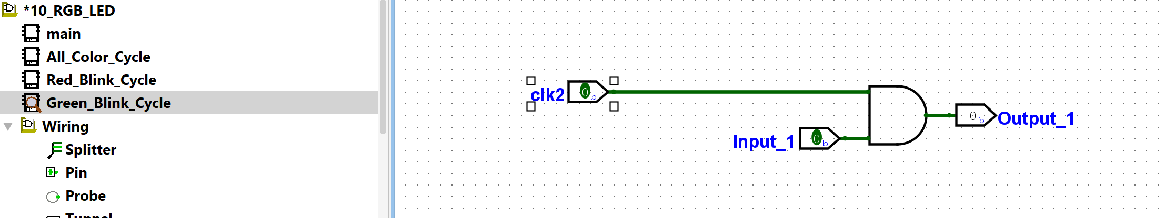
Issue w. behavior – Clocks are operating at the same rate.
Solution Ideation: the counter (as found for the multi-color swap) provides 3 bits. The LSB goes from 0-1 everyone. The MSB goes for 0-1 the slowest. Therefore, make the clock tied to the counter and one output of the counter.

Slide 9
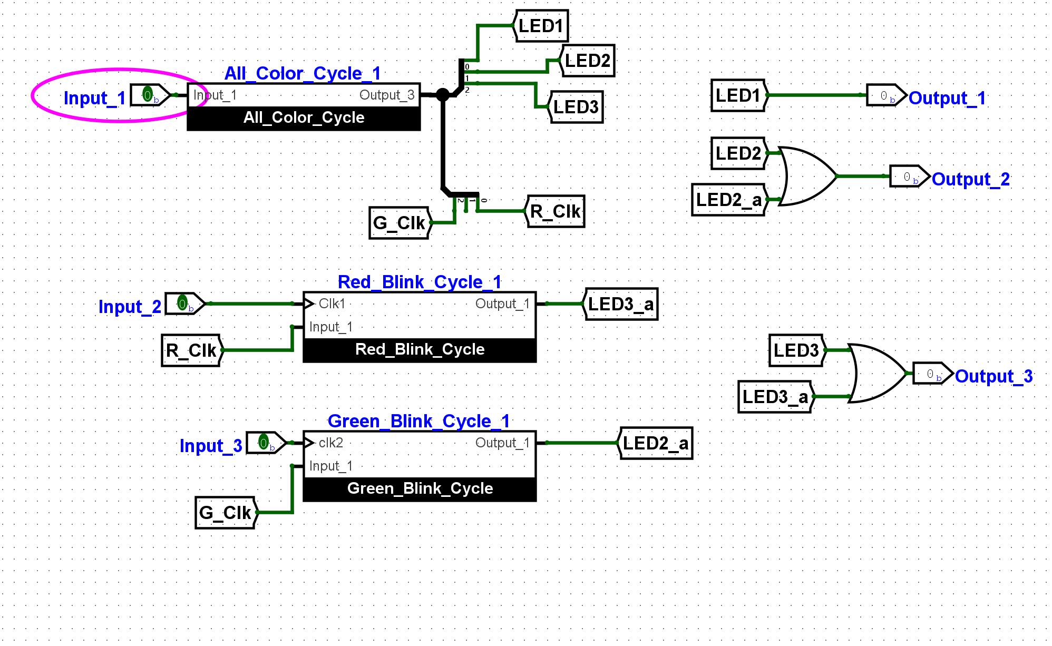
Success red and green operate at different rates
Issue: They only operate when the all color cycle is turned on

